Slide 1
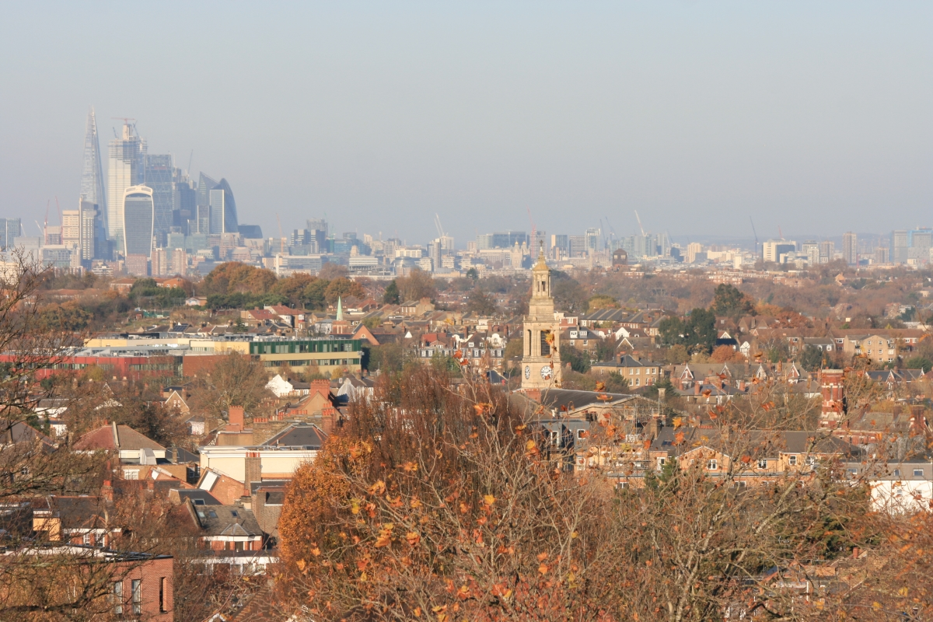

AGM Friday 14 August

Slide 2
Apologies
Minutes of last meeting
Chairs Report
Treasurers Report
Introduction of new committee for 2020-21
Agenda

Slide 3
There are no issues arising from our AGM last year at The Old Library.
So we will approve the minutes and move on my Chairs Report covering our work for the last year.
2019 Minutes

Slide 4
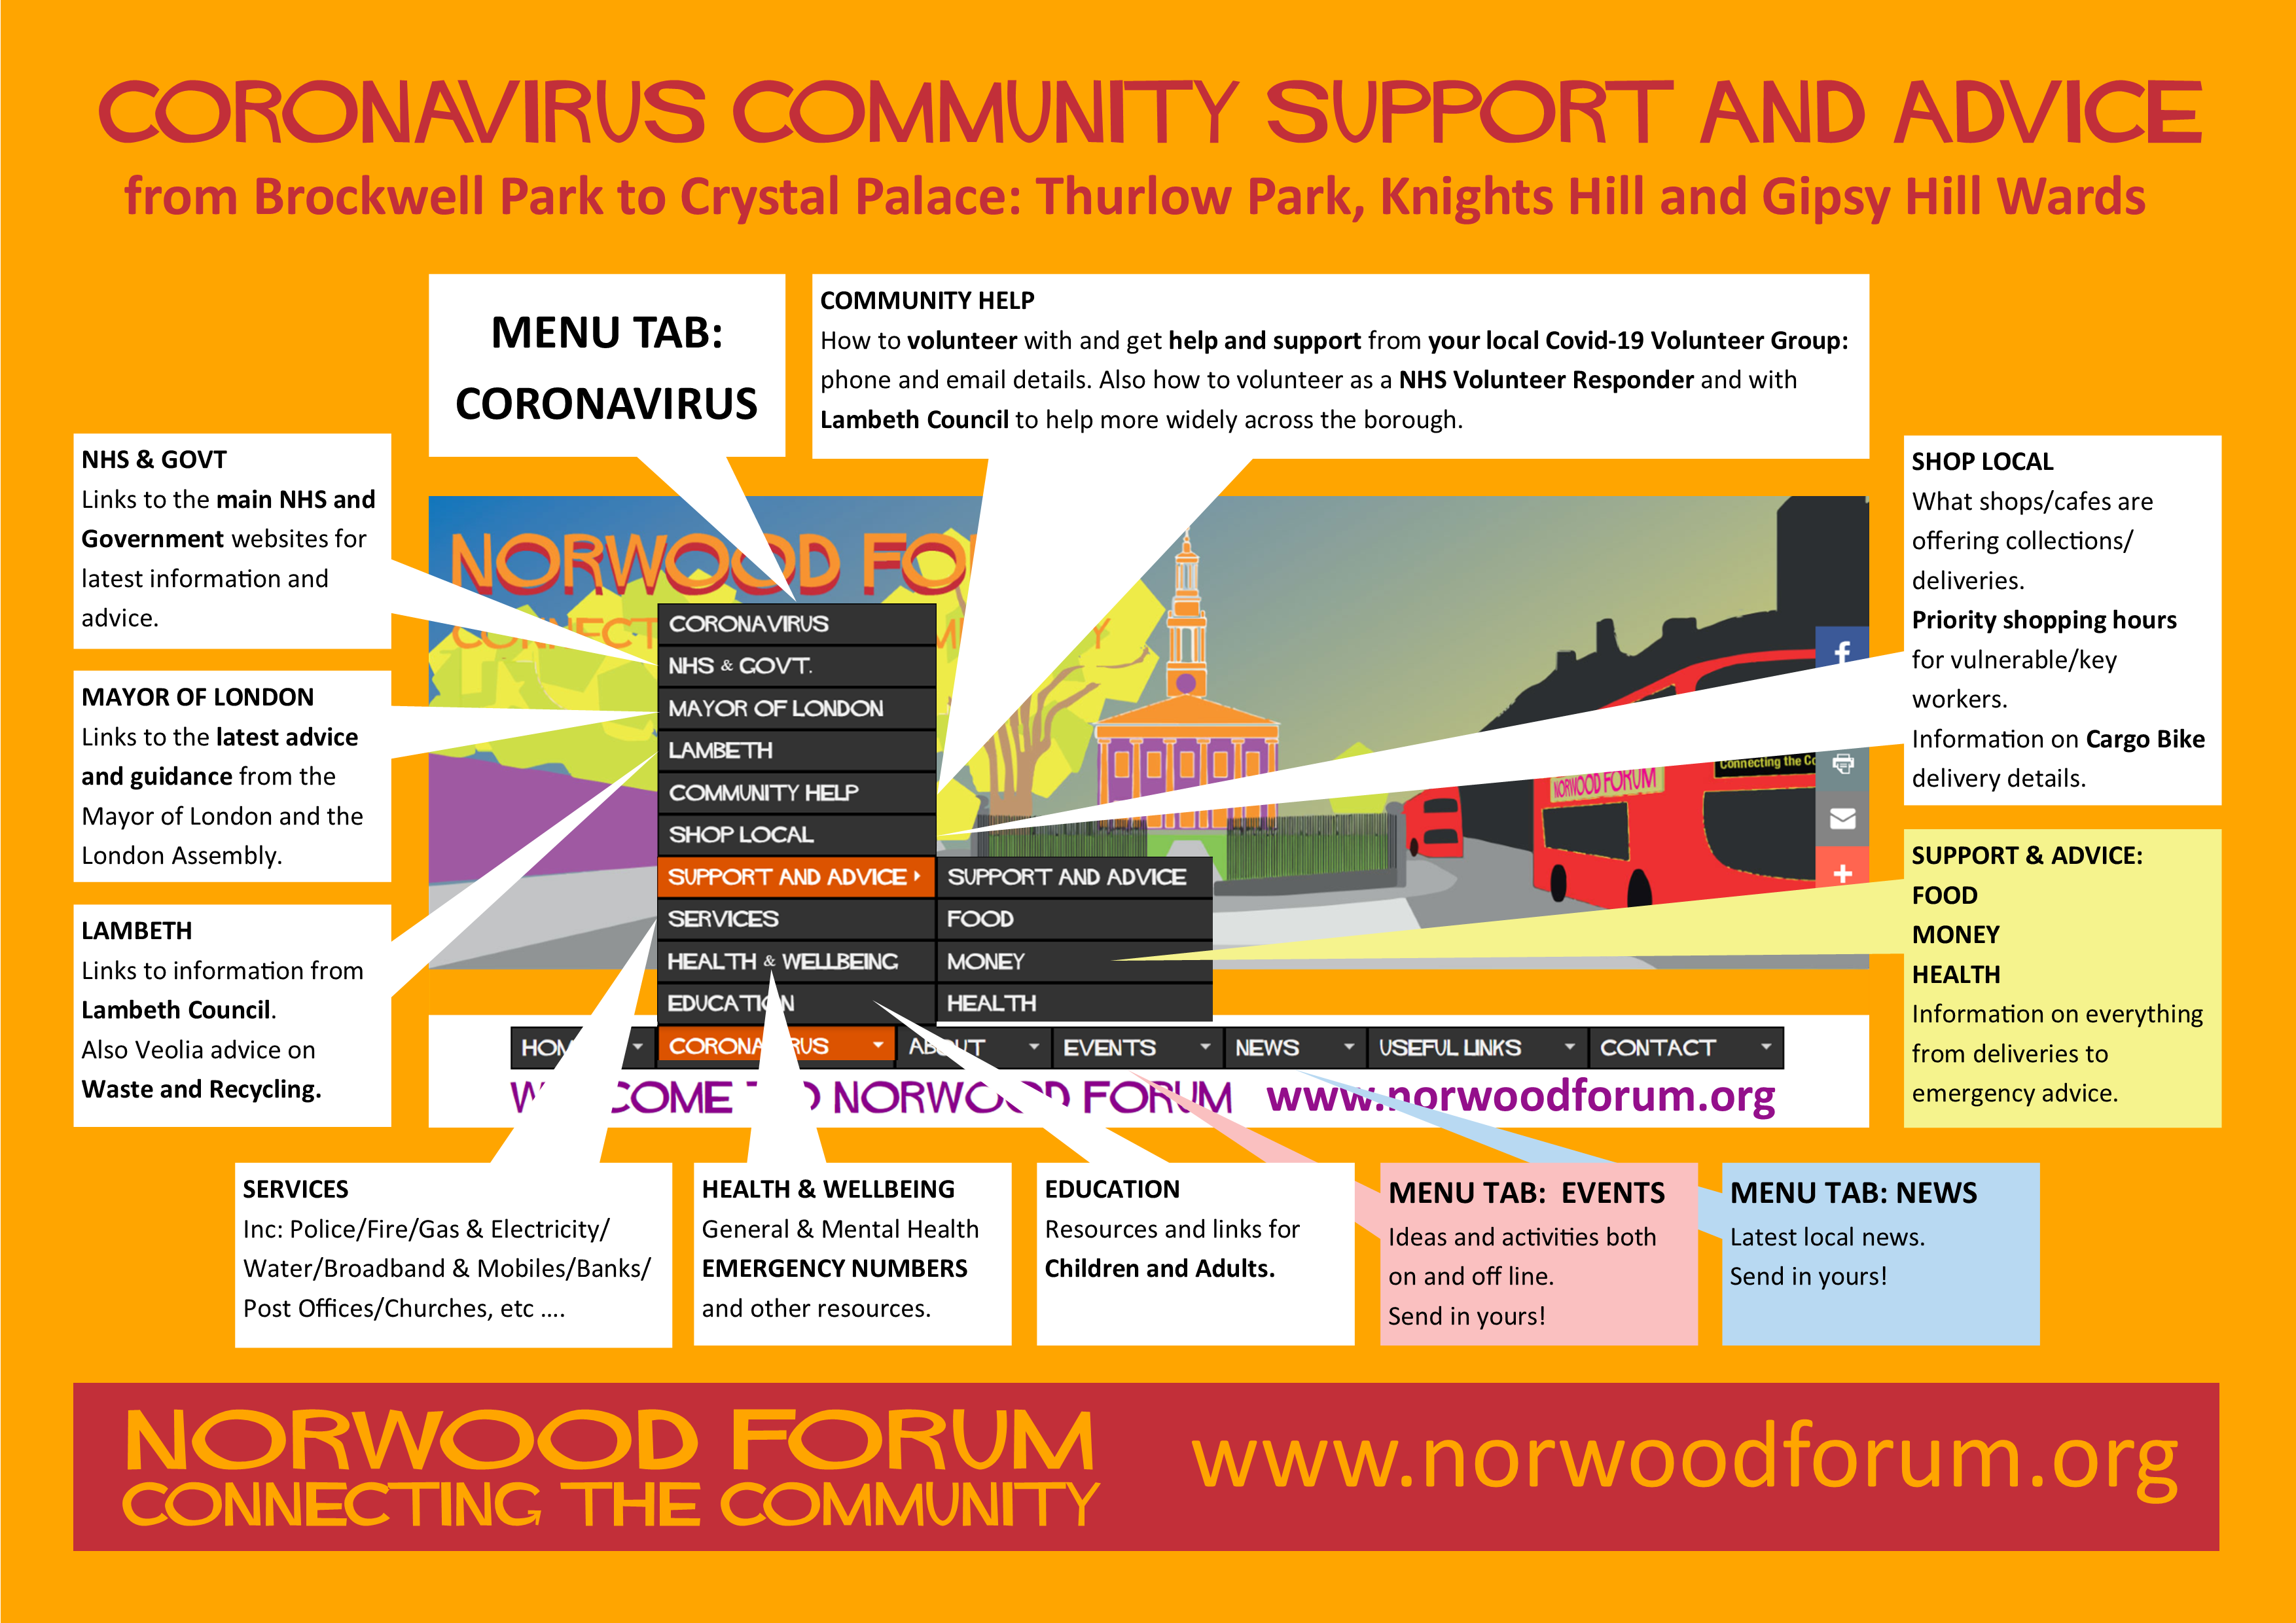


Lambeth AgeUK
Lambeth TechAid

Slide 5


1398 people reached
1980 people reached

Slide 6
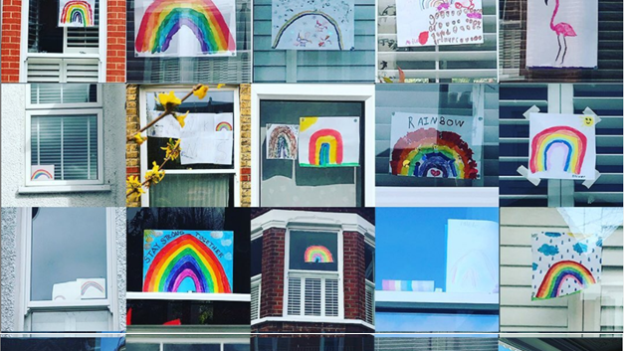
#rainbownorwood

Slide 7





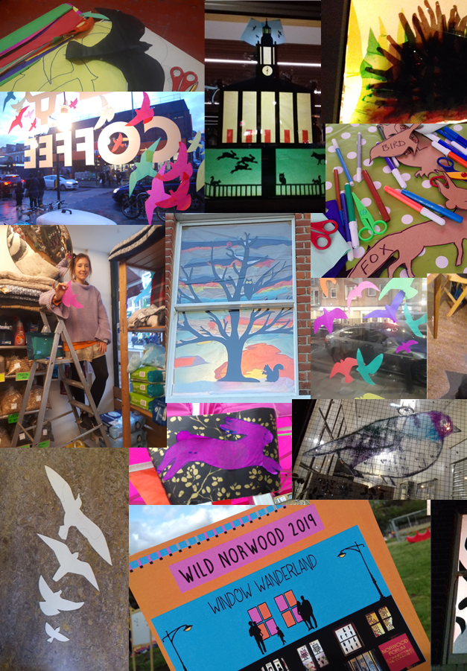
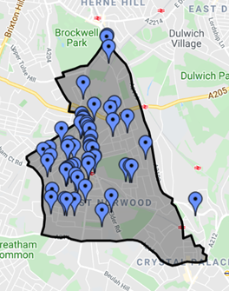
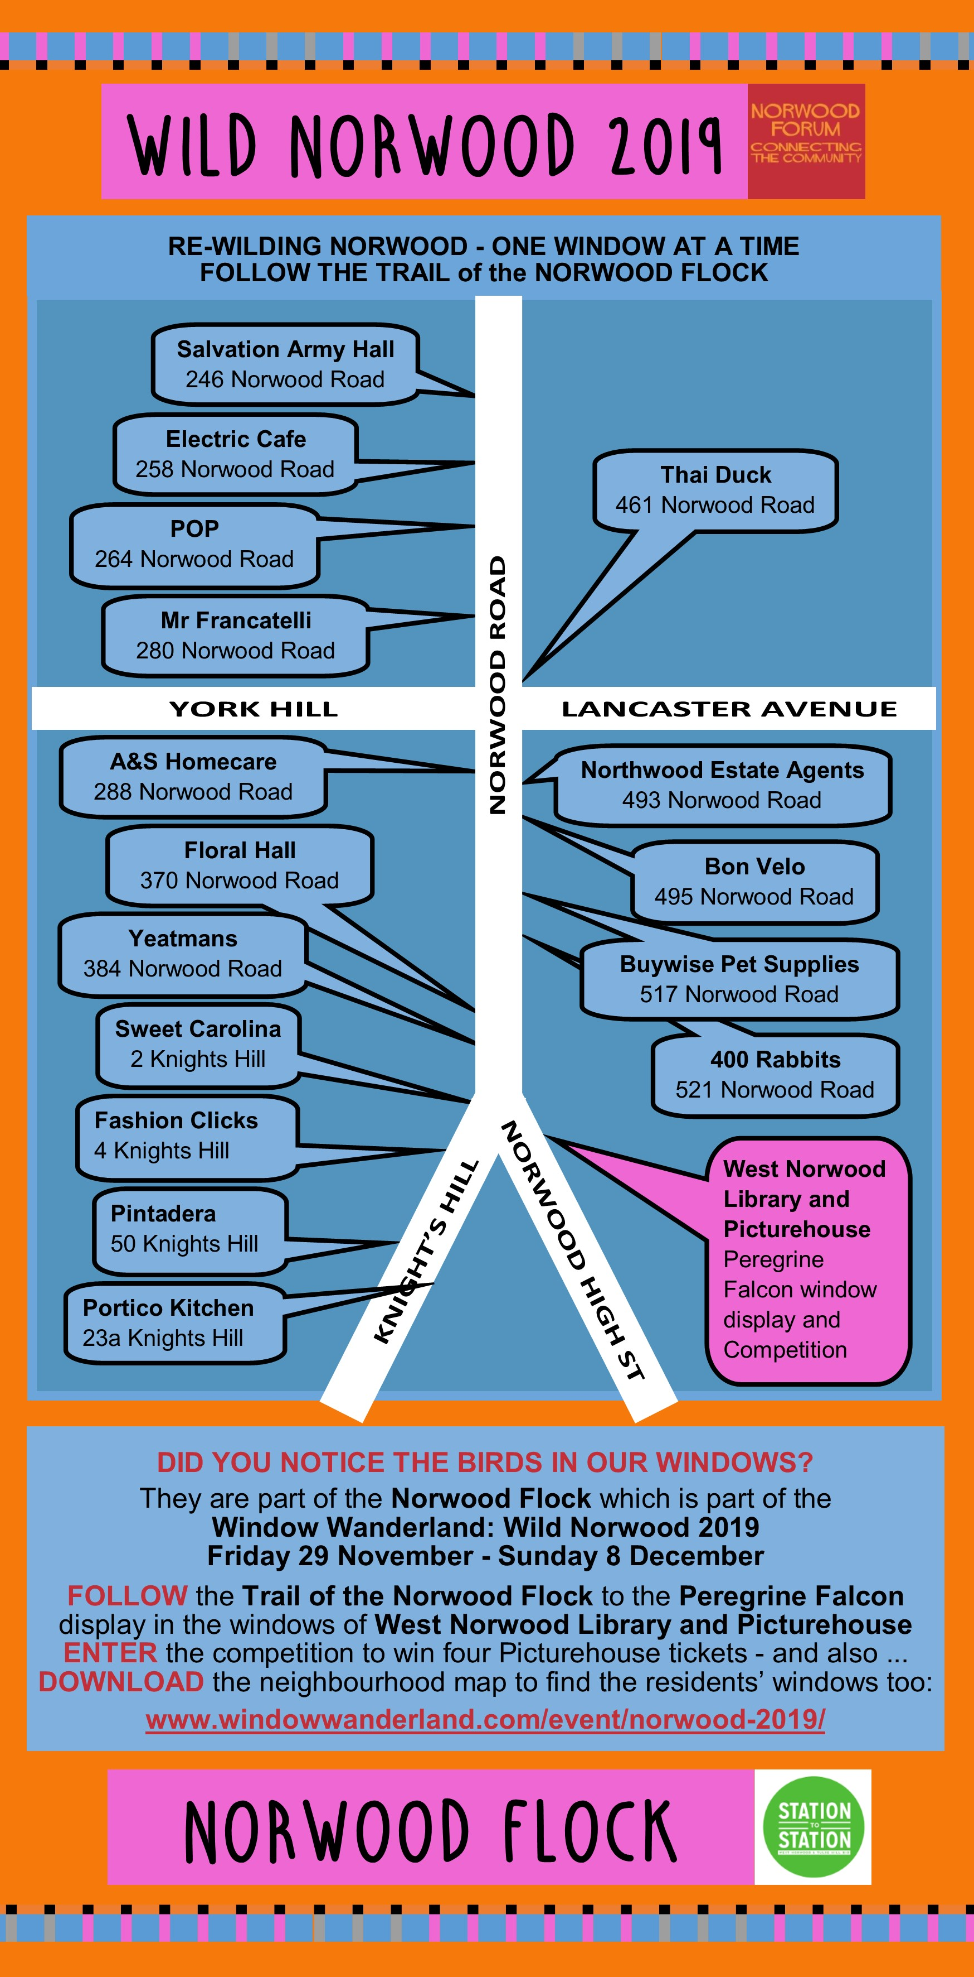
Participants:
60 windows – 17 shops and organisations, 41 residents,
2 schools.
Social media:
13,298 people reached
Festival map downloads: 2440

Slide 8
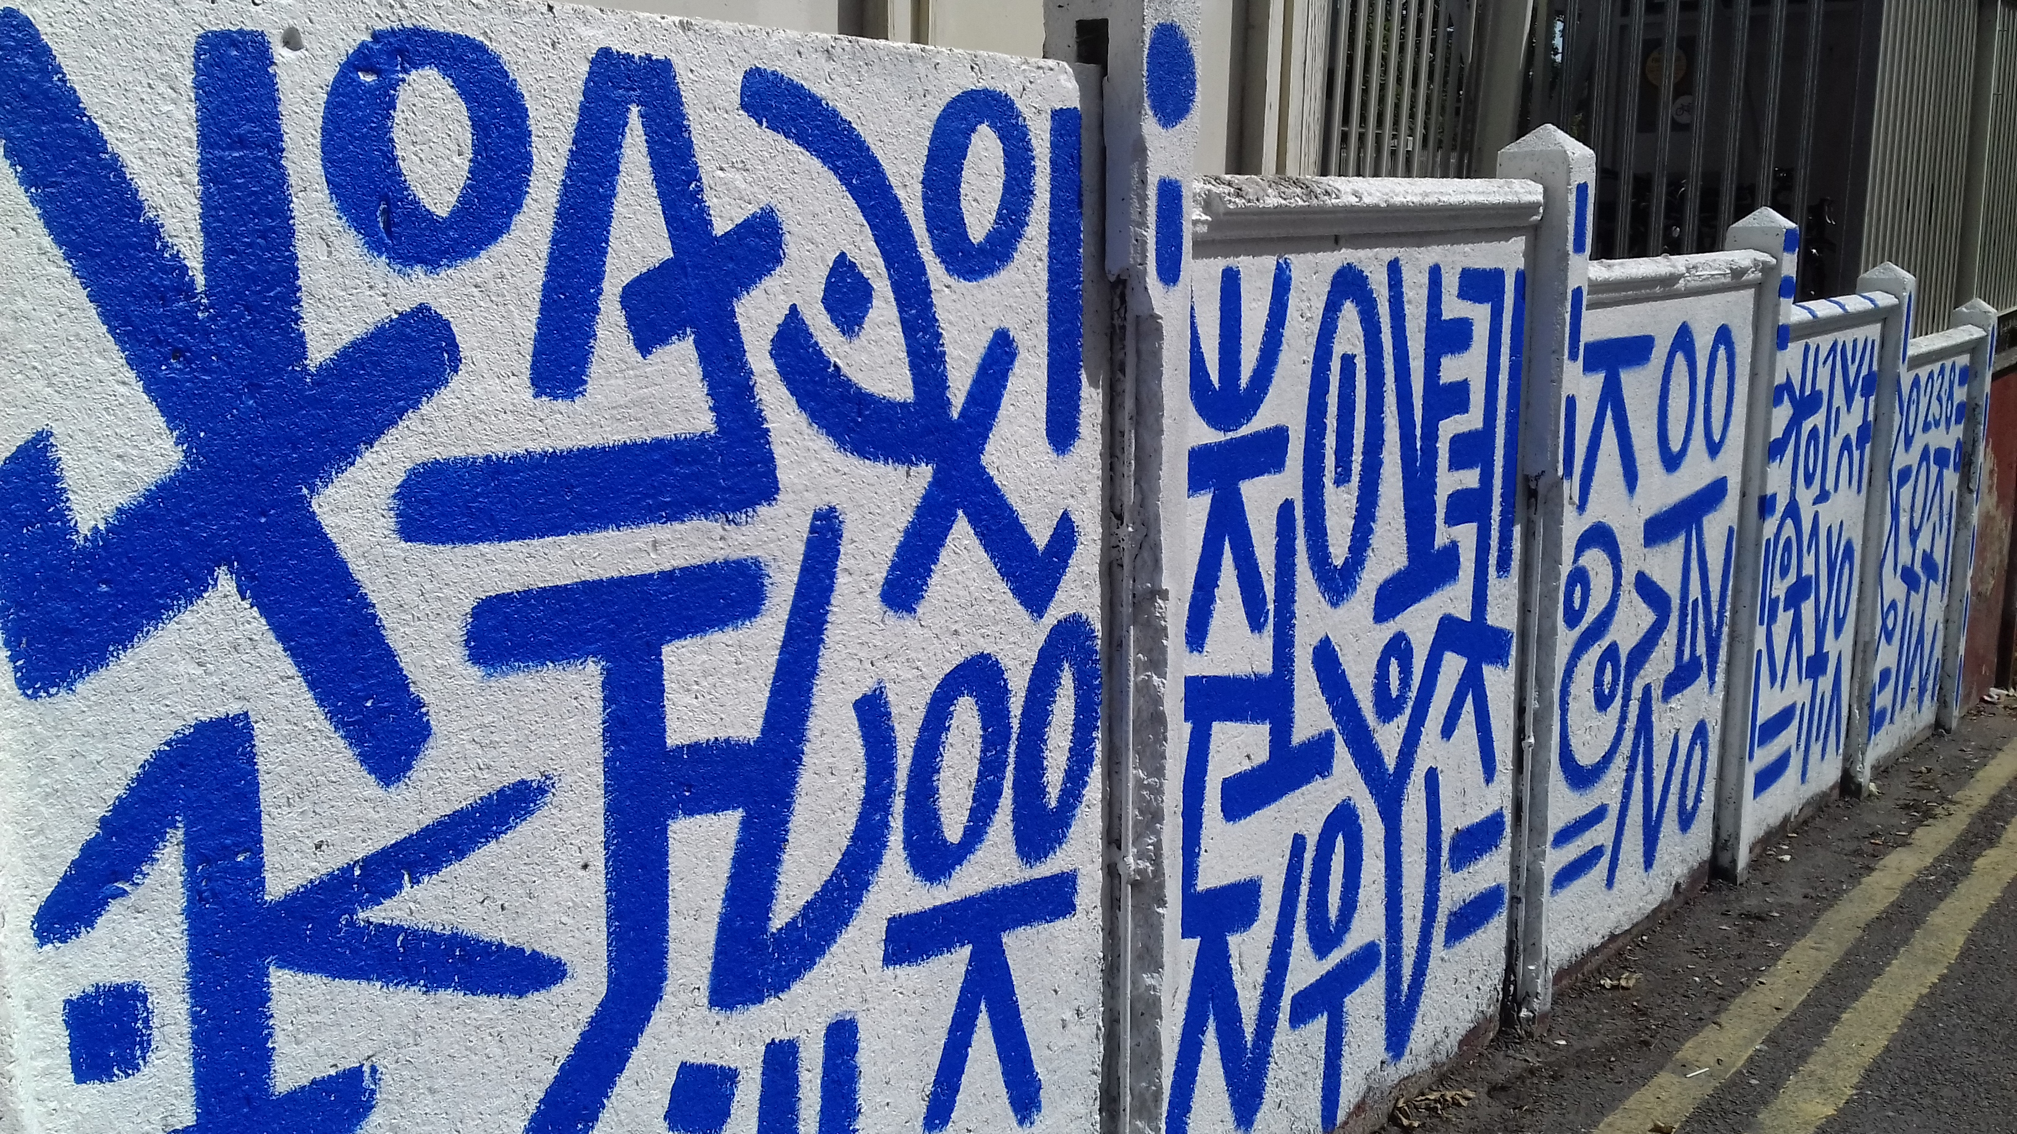

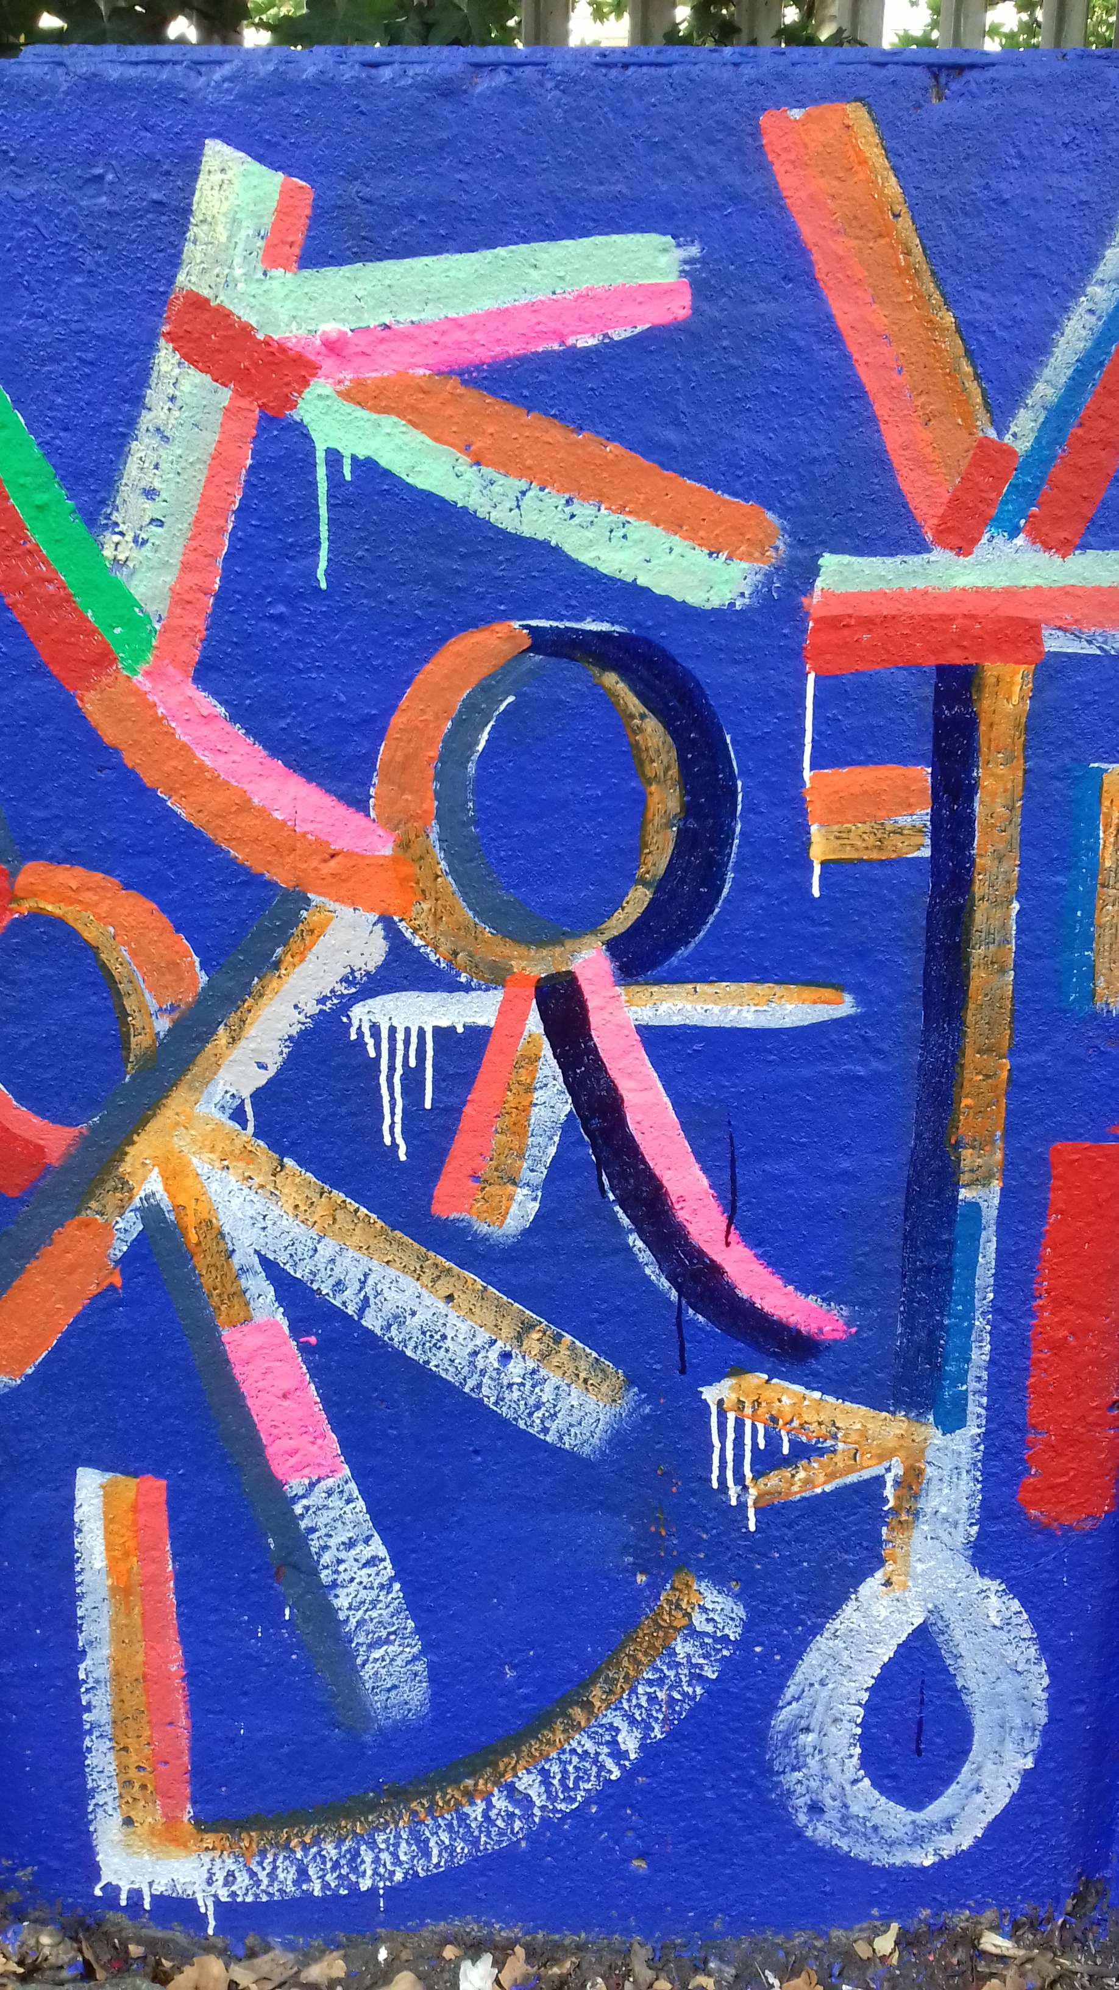
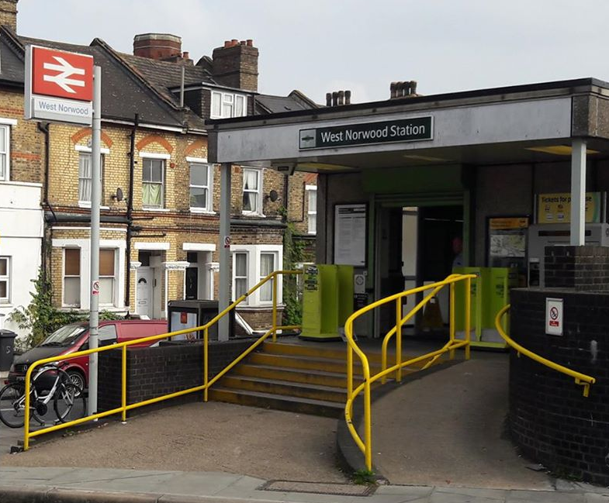

Cotswold Street Mural

Slide 9

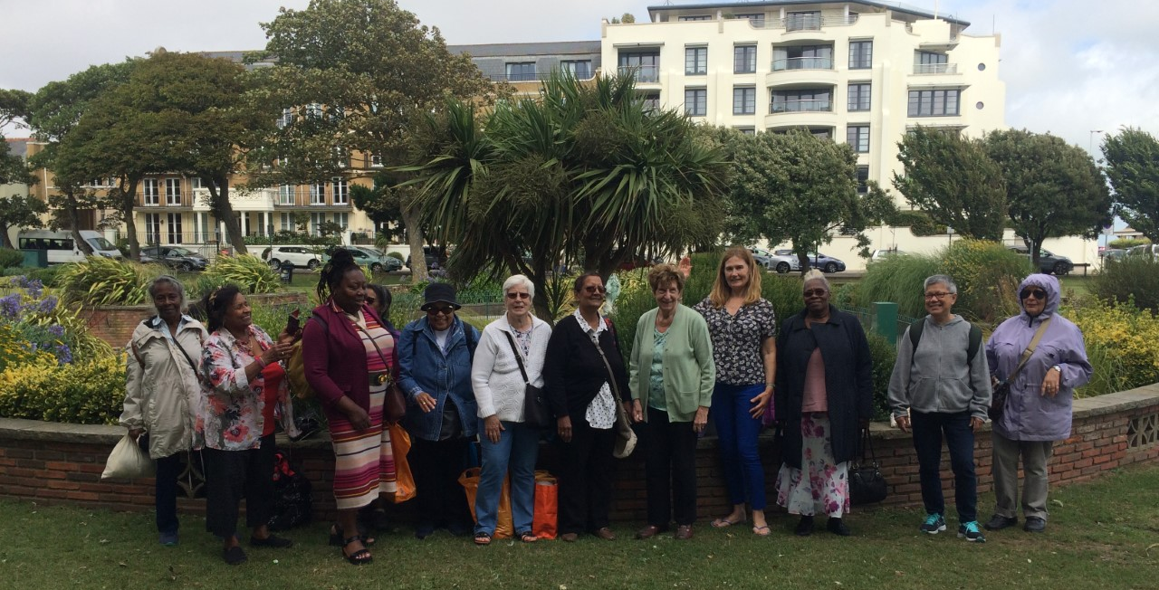
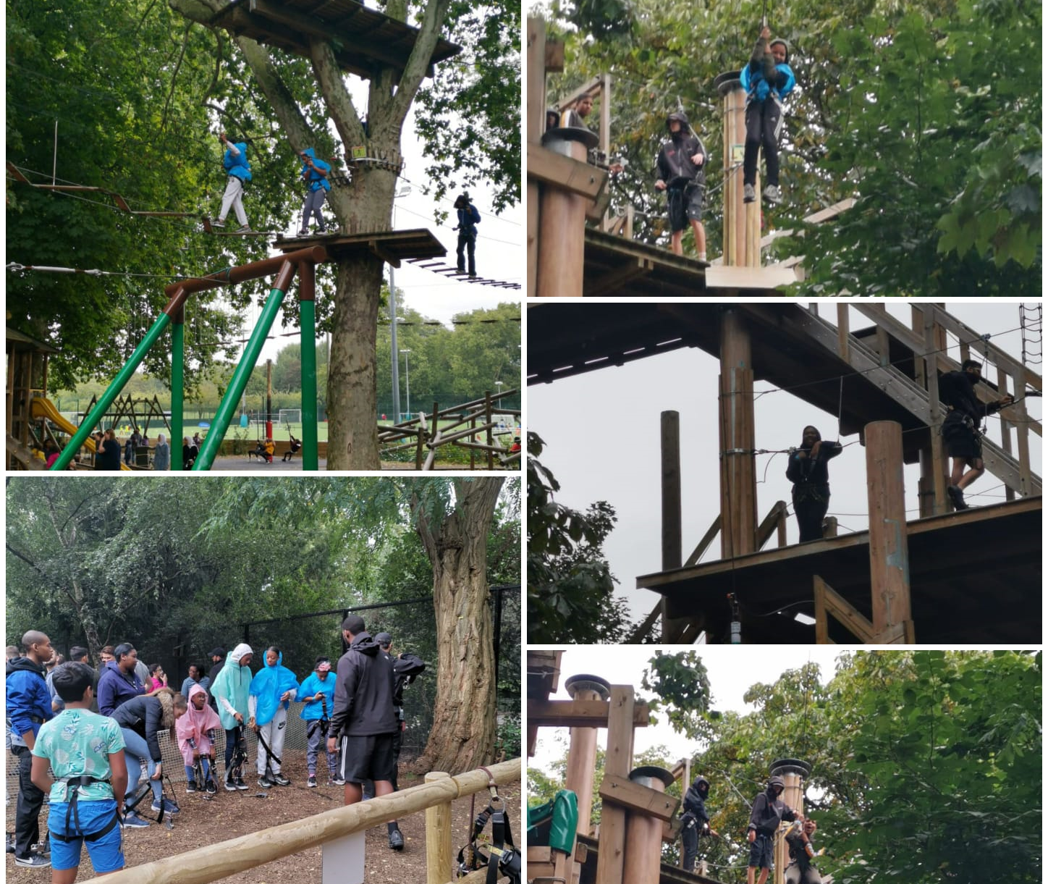

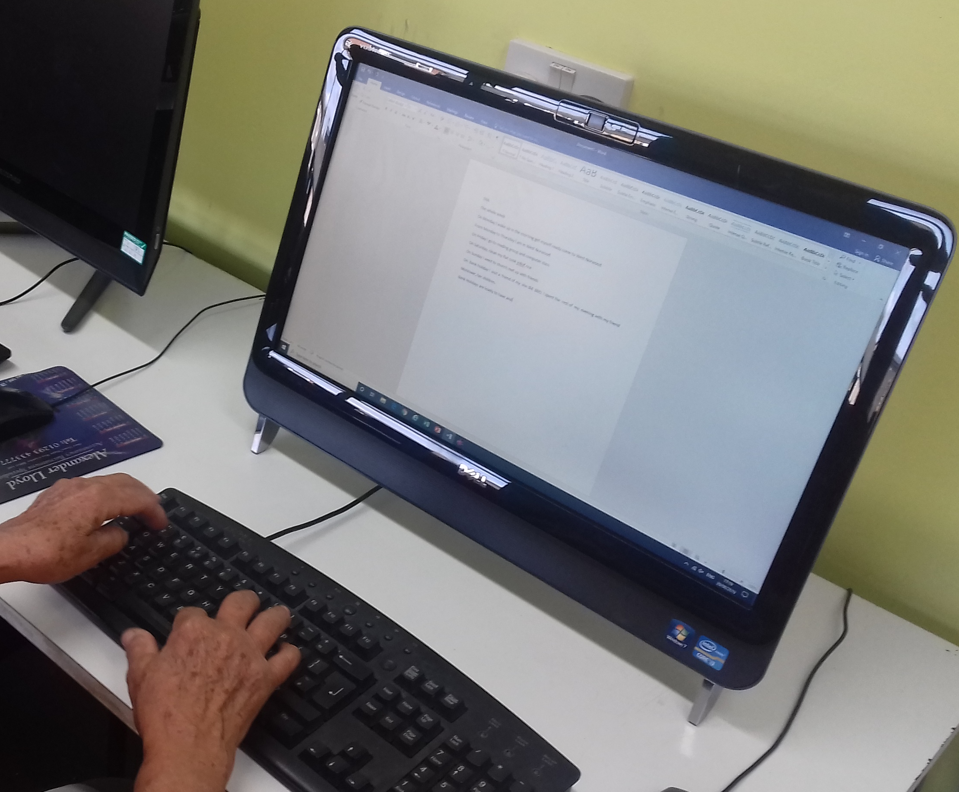

Norwood Pensioners Group – coach trip
Rathbone Children and Young People Services - peer to peer support and team work visit to Go Ape ‘Tree Top Challenge’
Southside Rehabilitation Association (SRA) – new training computer
Community Grants

Slide 10


A major focus of our “Connecting the Community” has been the Community Safety Partnership and the main objective for 2019-20 has been introducing and supporting activities which cross social, cultural and organisational boundaries, including those planned by the Police, NHS and Council.
There were three physical meetings before the COVID 19 Lockdown. Each led to practical co-operation between players who had not previously met, as well as agreement to support programmes already being planned by others.

Slide 11
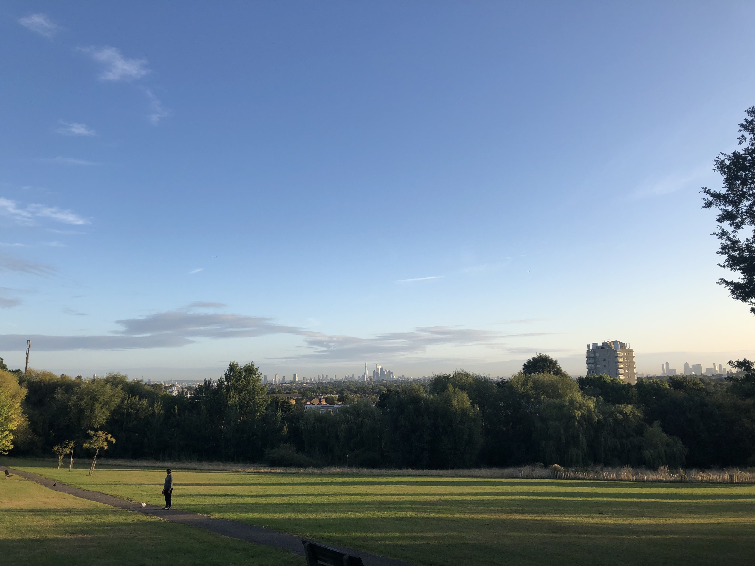


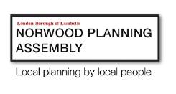
Clean Air Norwood?
Tuesday 24 September 2019

Slide 12
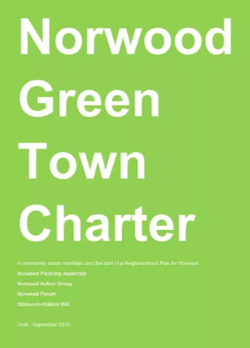
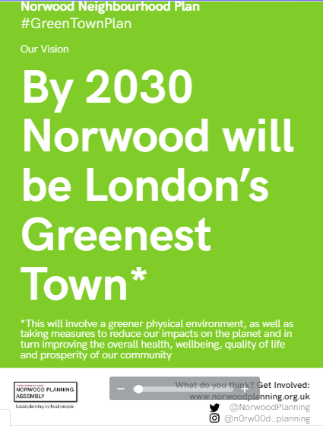
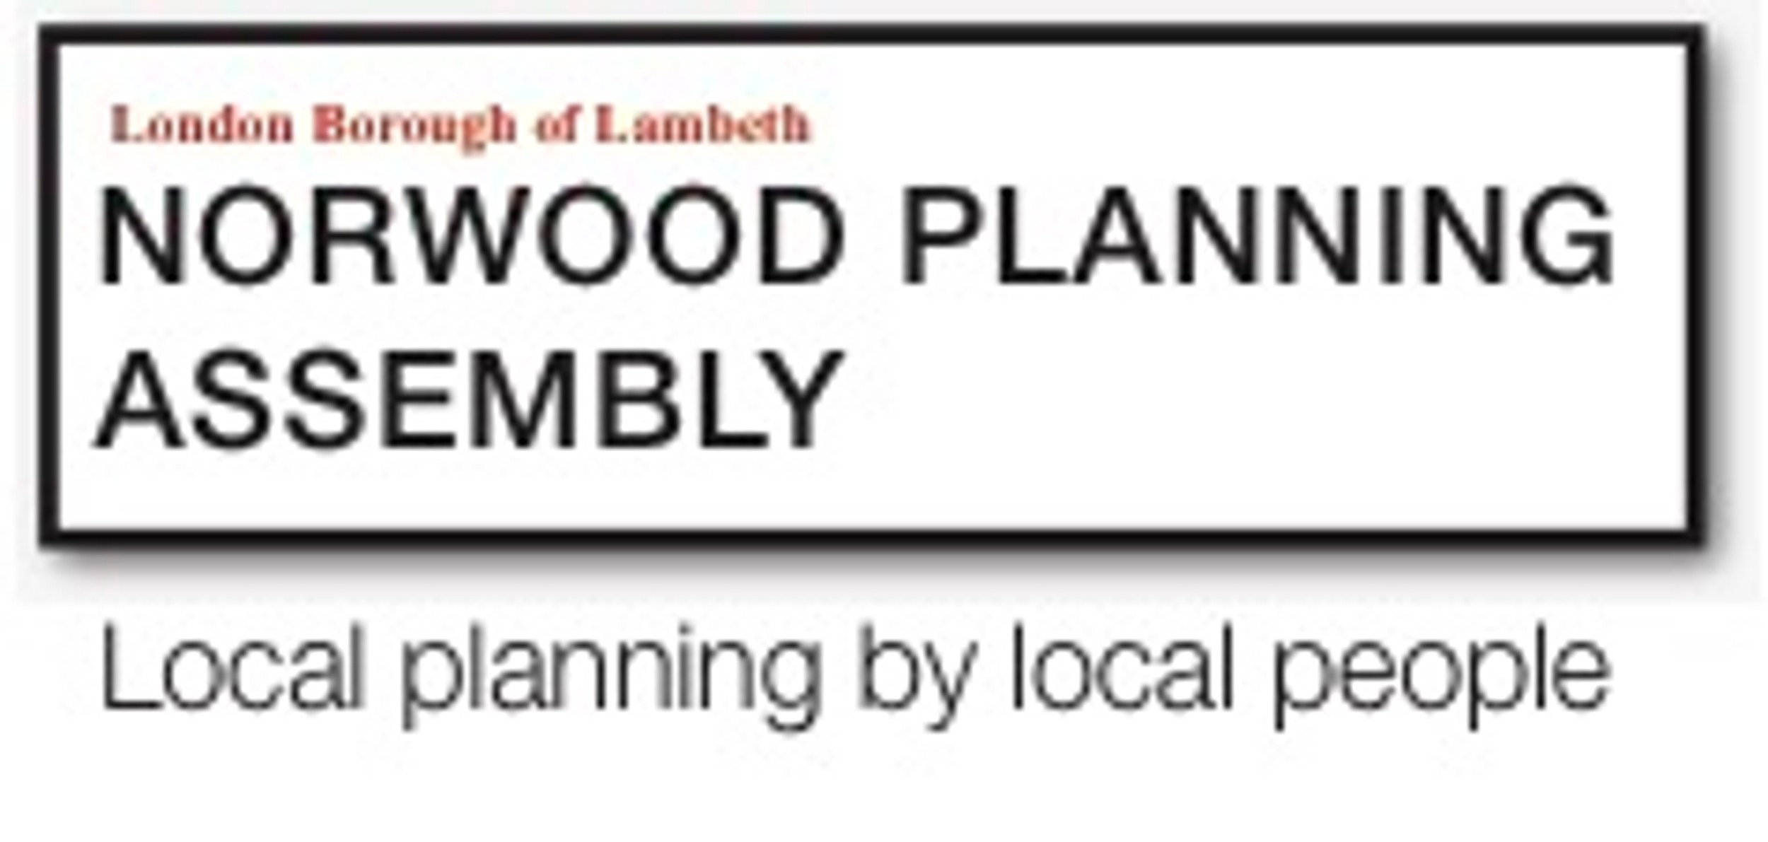

Slide 13
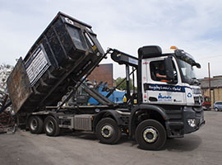
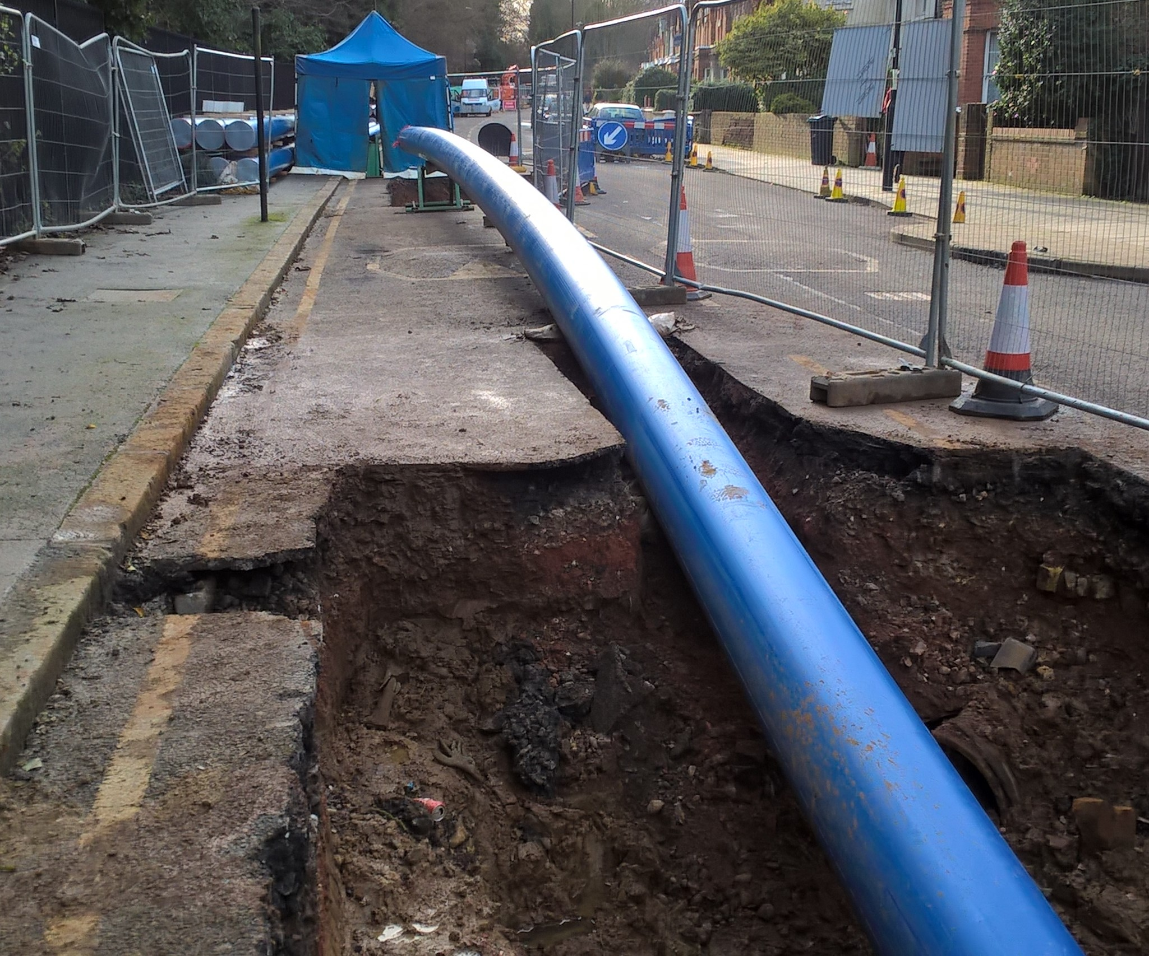
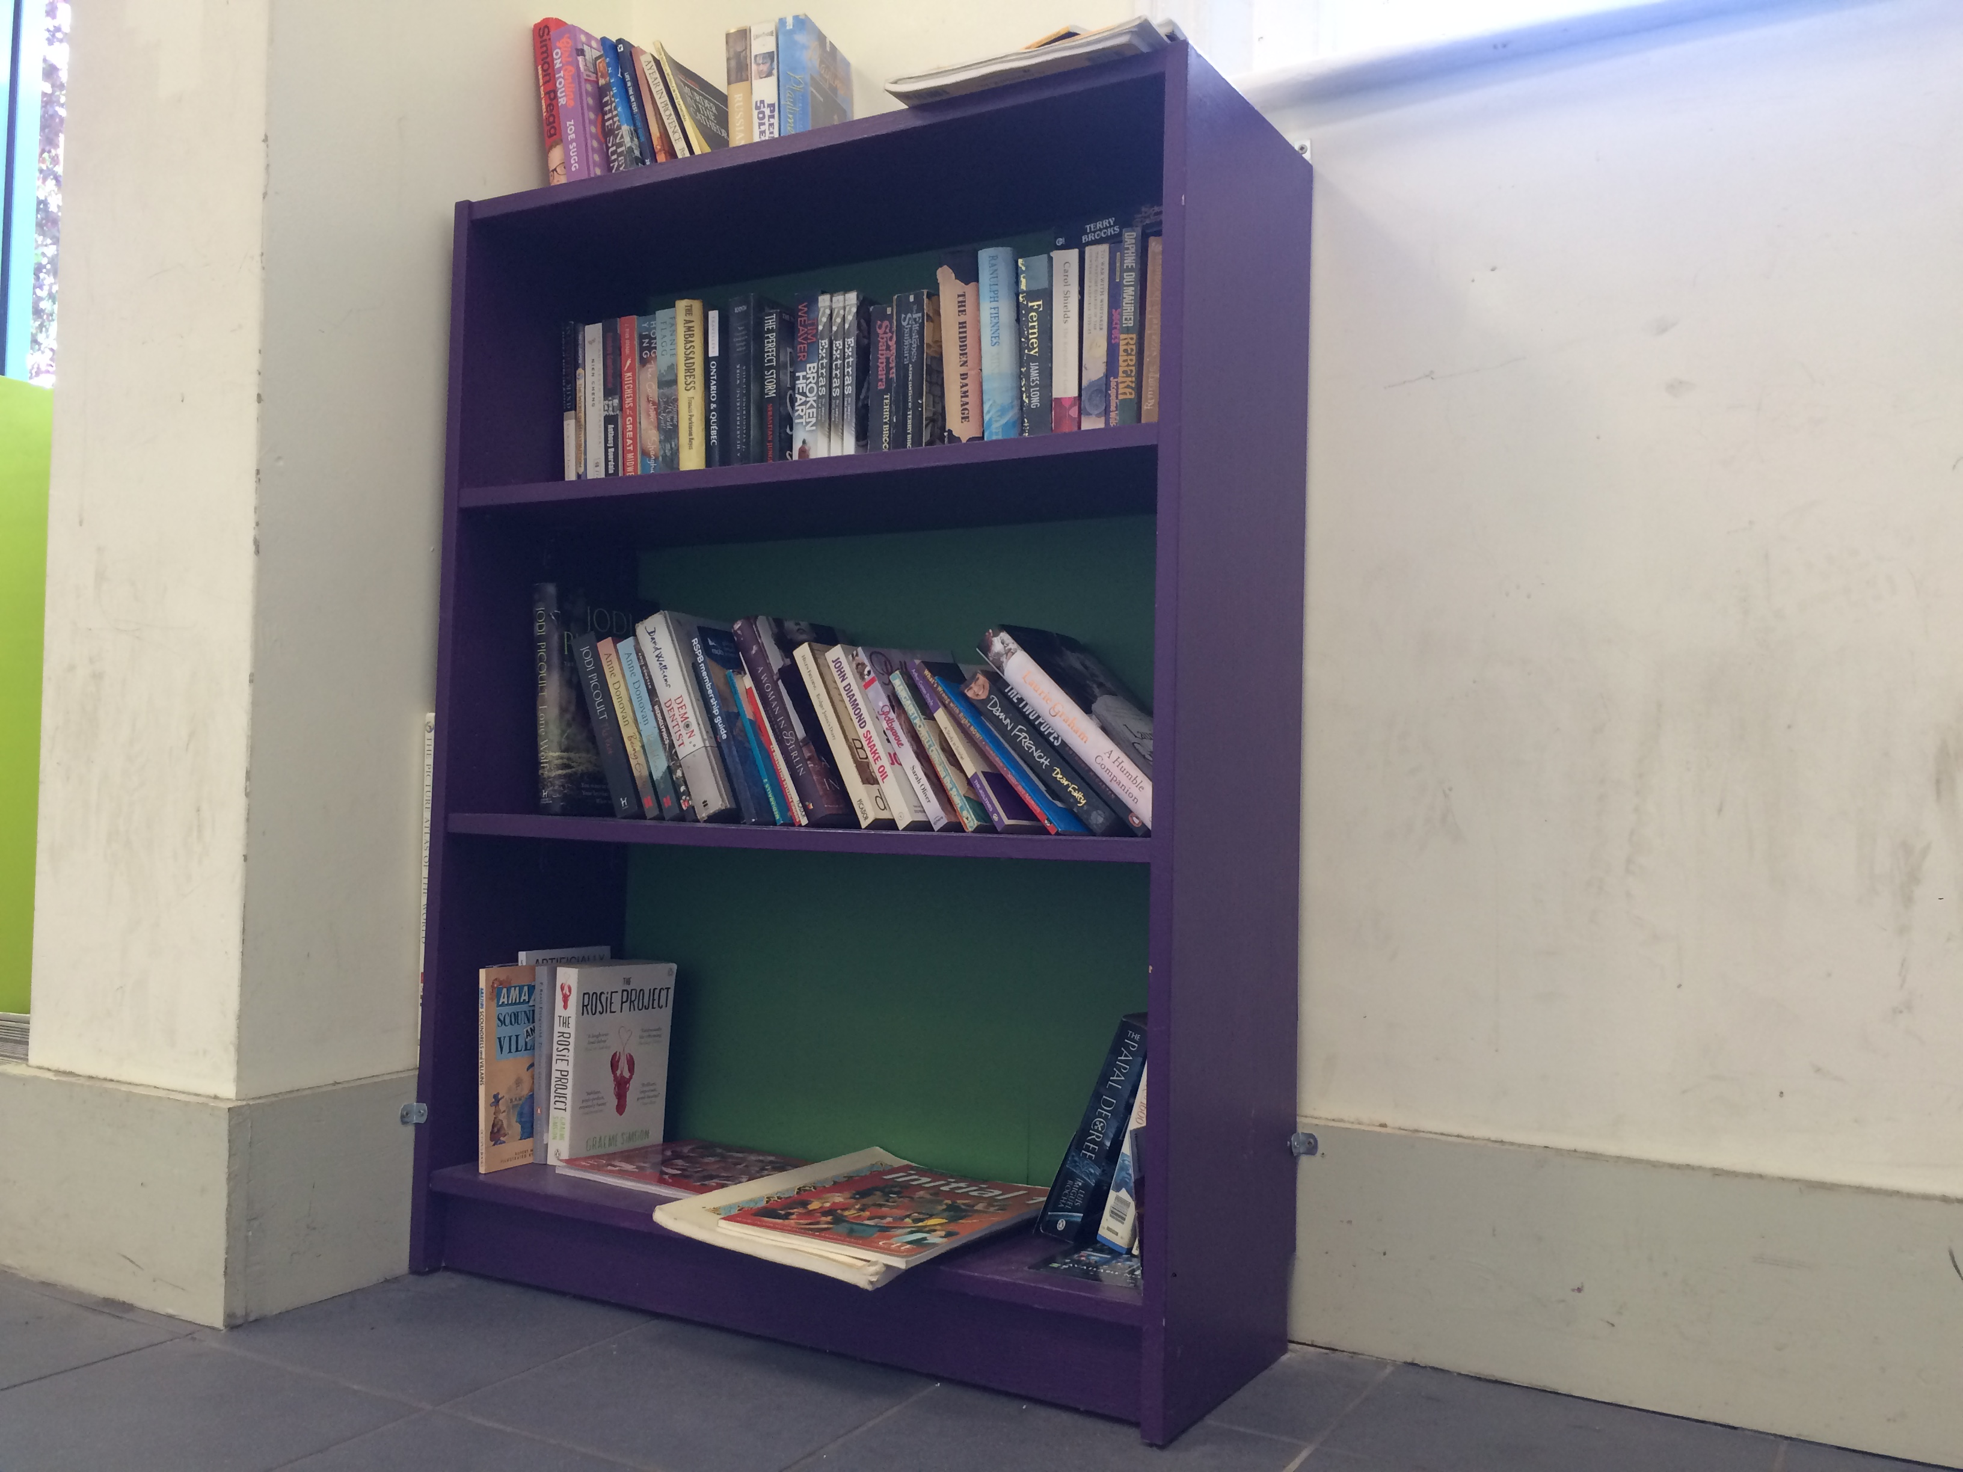

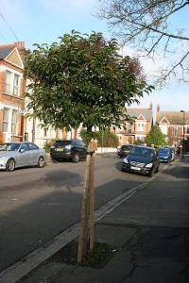
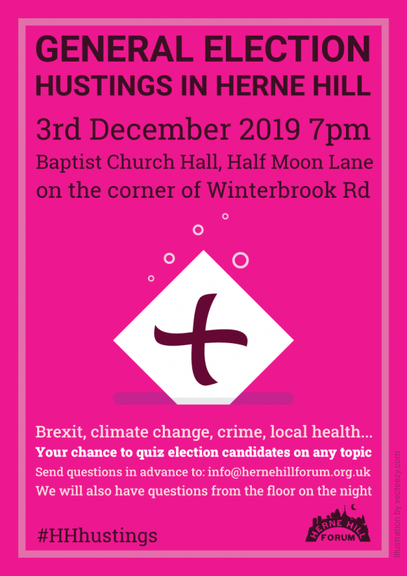


Community Bookcase
Thames Water
Planning
Other Activities
Tree Pits
General Election Hustings

Slide 14

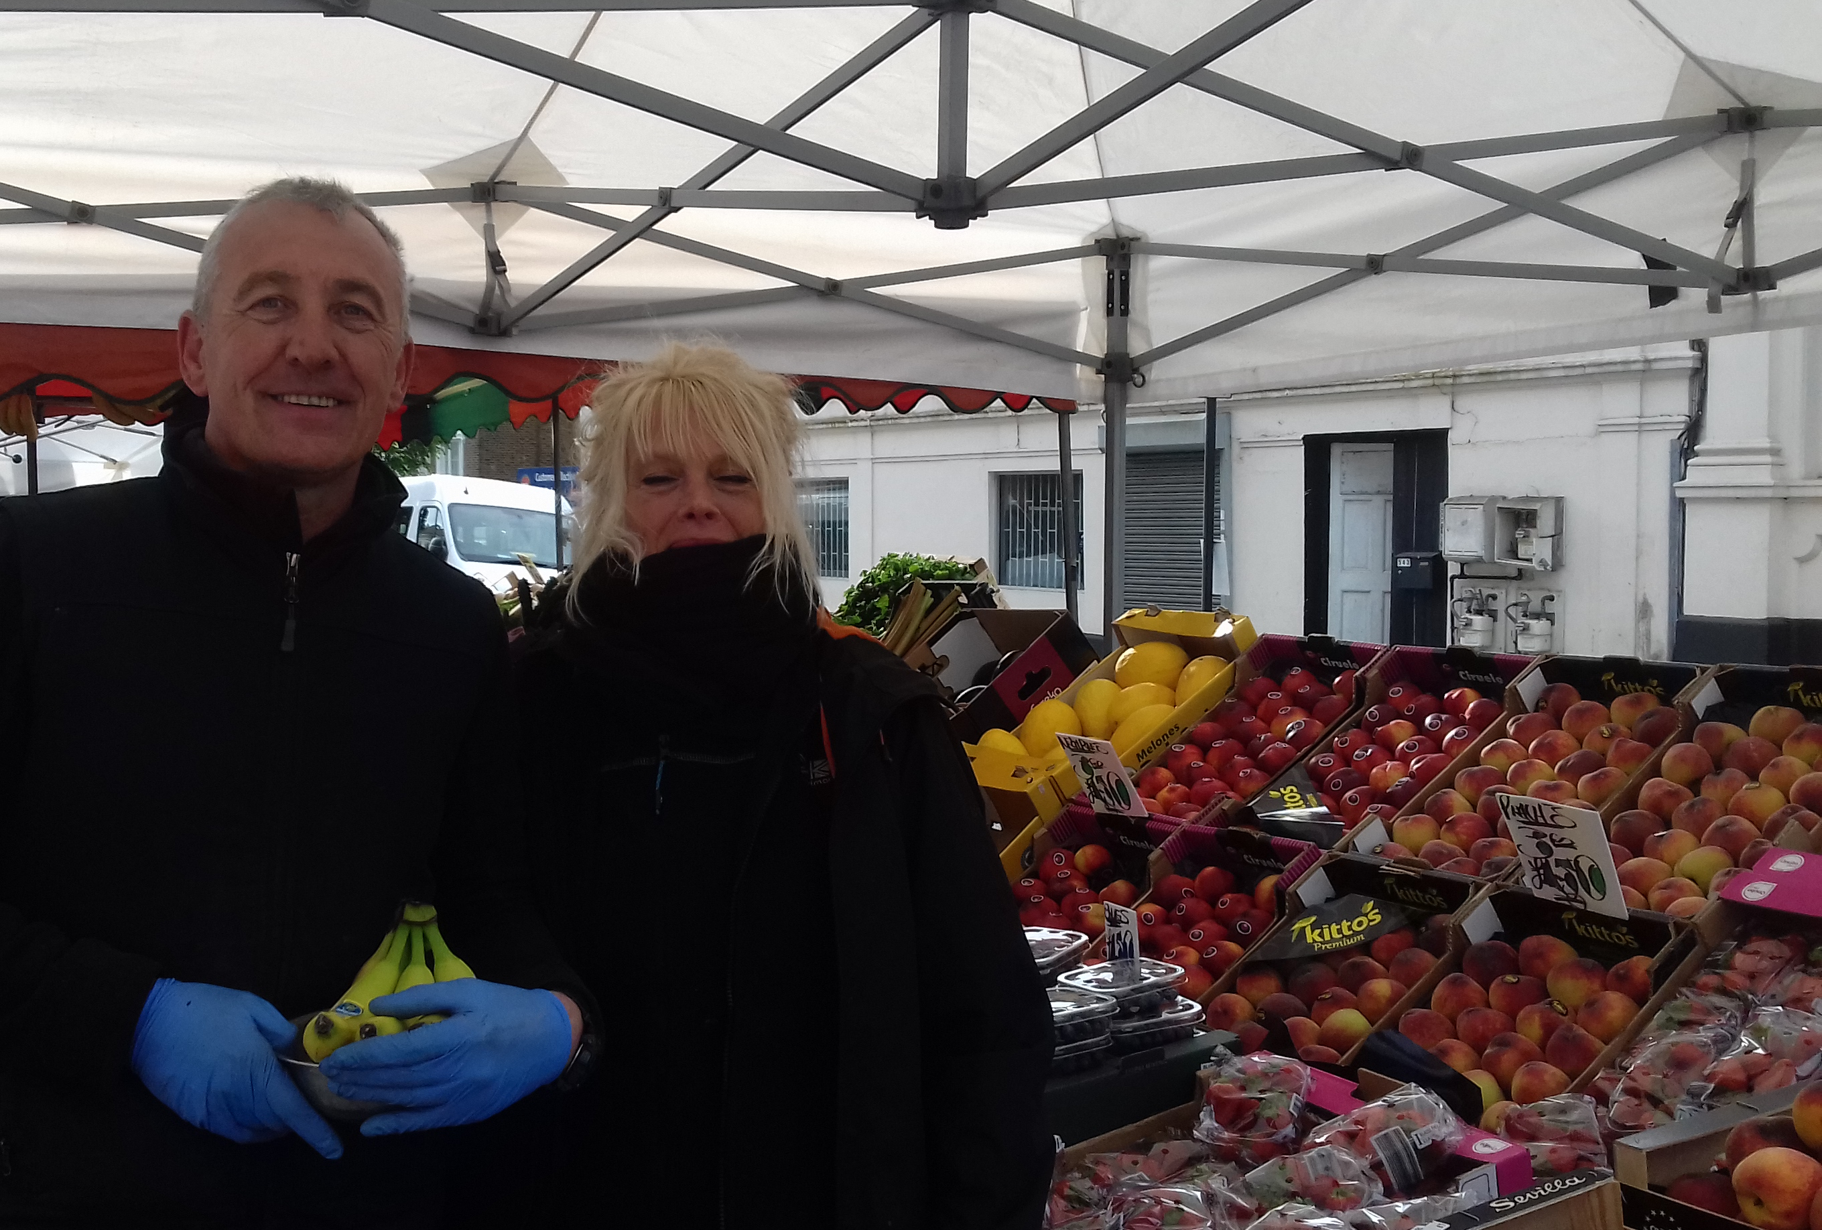
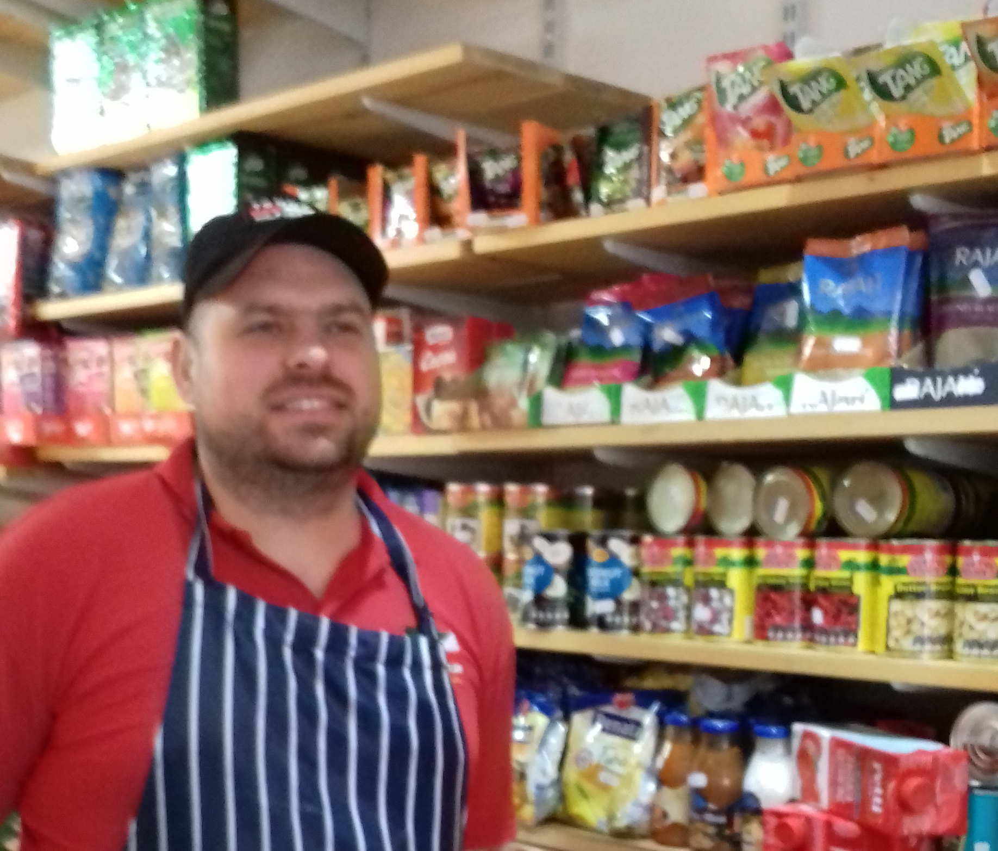
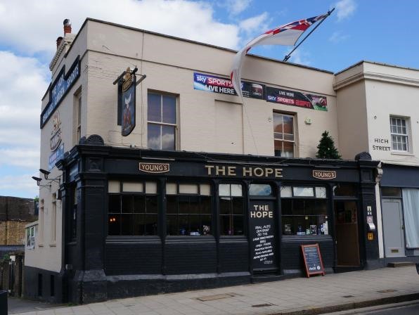







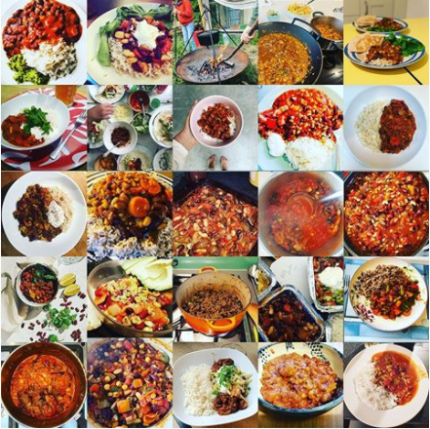
Participants: over 100 households
You Tube video's: 980 views
Social media reach:
12,568 people
#StayHomeSundaySupper

Slide 15
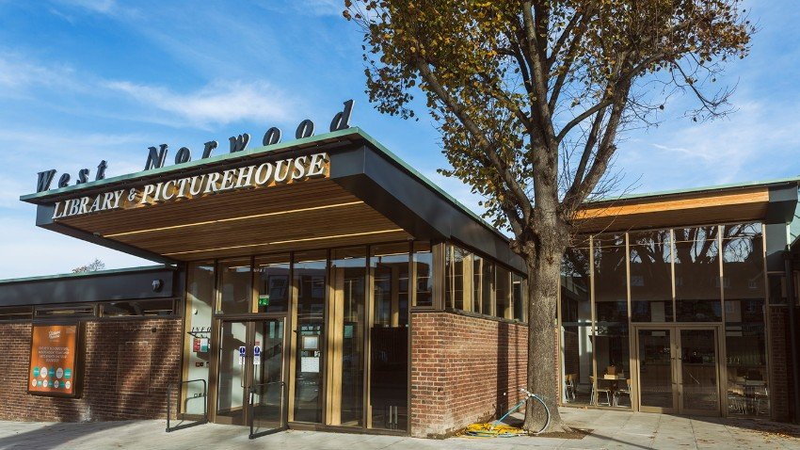
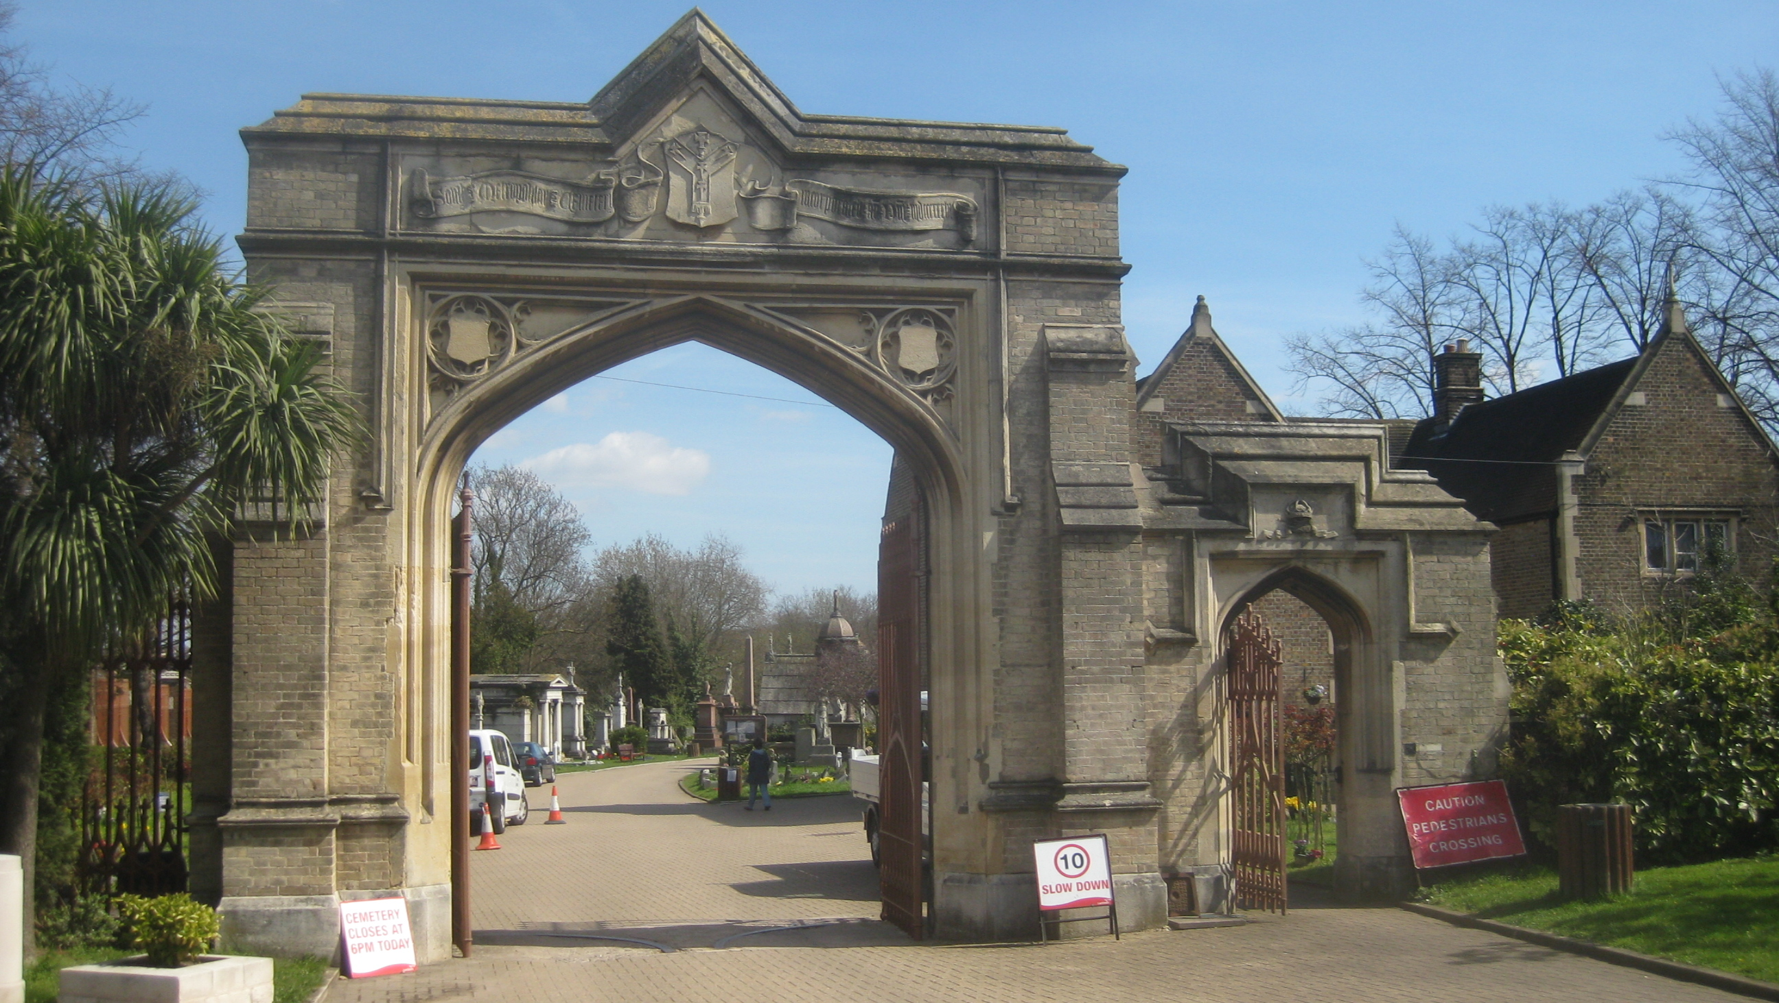
West Norwood Library and Picturehouse
West Norwood Cemetery

Slide 16

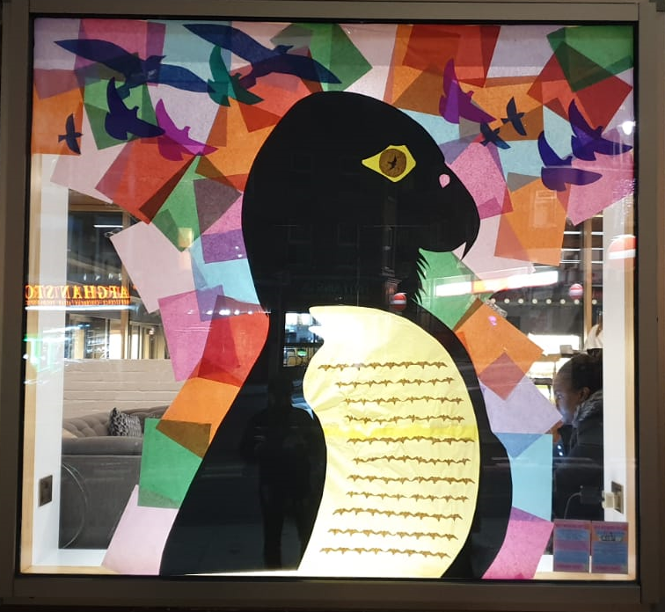
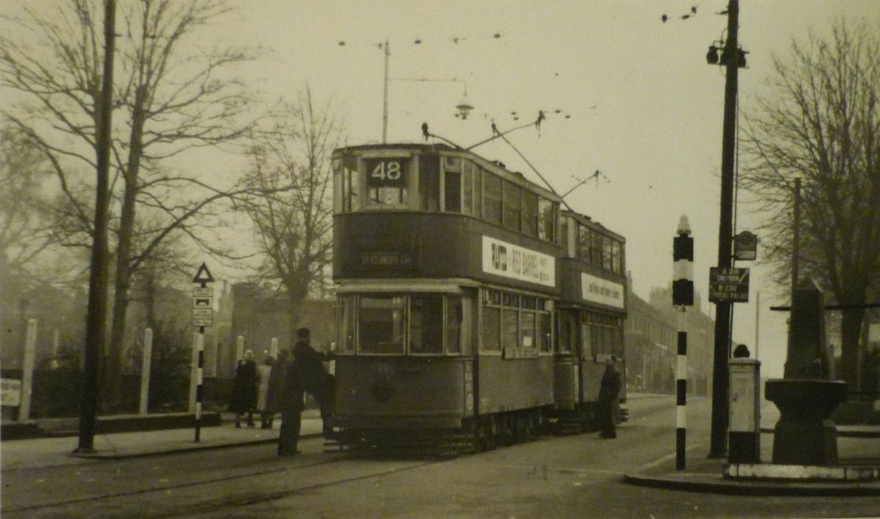
Tram Terminus
Horse drawn trams started on 4 June 1885
changing over to electric on 30 May 1909
Trams ran from here to
Victoria, the Embankment and as far
as Manor House, north London
The last tram ran on 7 April 1952
Highlighting two
2020-21 projects
www.norwoodforum.org
Blue Plaque scheme
Window Wanderland 2020

Slide 17
Treasurers Report

Slide 18
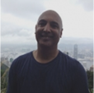
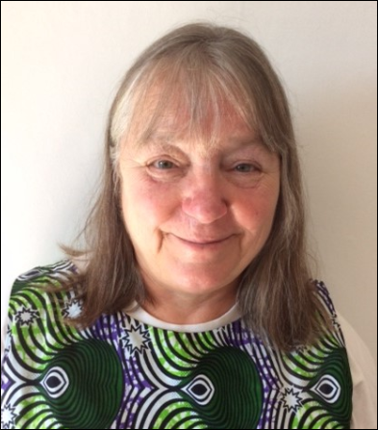
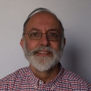
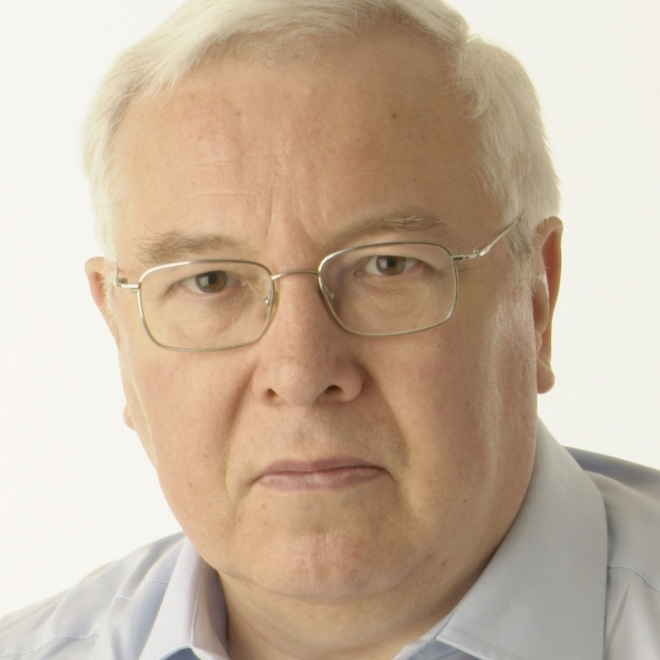
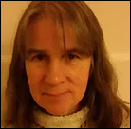
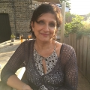
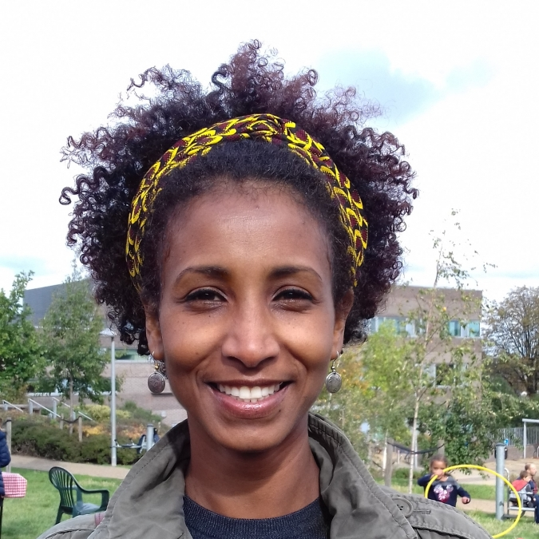

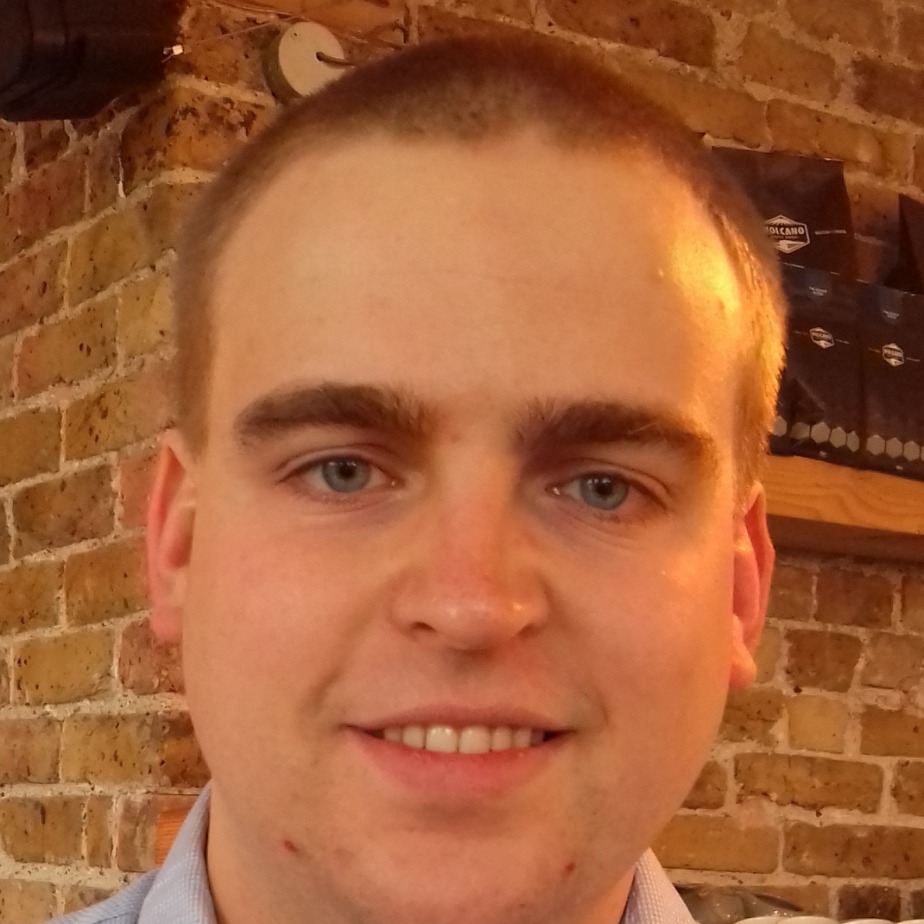
We have fewer people standing than places so there is no need for an election.
If you are interested in being involved, please get in touch:
info@norwoodforum.org
From top left:
Sunil de Sayrah, Chair
Kim Hart, Vice Chair
Noshir Patel, Treasurer
Philip Virgo
Anne Crane
Su McLaughlin
Ibtisam Adem
Gloria Orosungunleka
James Davis
2020-21 Committee

Slide 19
Thank you

